Slide 1
Text Data
Lecture 4

Slide 2
Organization of Lecture 4
  Processing HTML Files
  Handling CSV Files
  Reading JSON Files
  Processing Text in Natural Languages

Slide 3
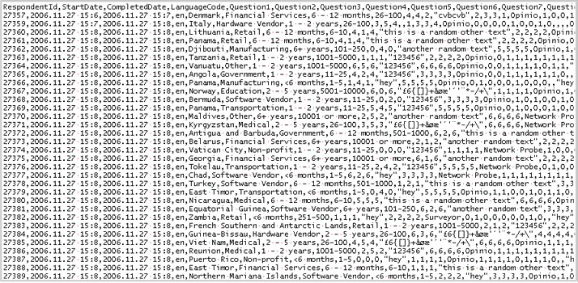
Origins of Raw Data
  Structured docs (HTML, XML, CSV, and JSON files)
  Unstructured docs (plain, human-readable text)
    Hardest to process and where programming skills necessary
  All these are readable by human
  Can open any in a simple text editor (eg. NotePad)
  Anaconda has modules for text analysis
    – BeautifulSoup, csv, json, nltk

Slide 4
Processing HTML Files
HTML – markup language used on web for human-readable representation of information
HTML document
  Consists of text and predefined tags in < >’s
  Control presentation and interpretation of text
  Tags may have attributes
  Table 3 shows some tags
    <HTML>, <HEAD>, <TITLE>, <BODY>, <H1>, <i>, <b>, <span>, <br>, <img>, <table> , <li>

Slide 5
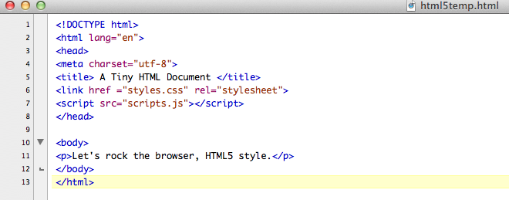
A Tiny HTML Document
Meaning of text is available in Alt Text box.

Slide 6
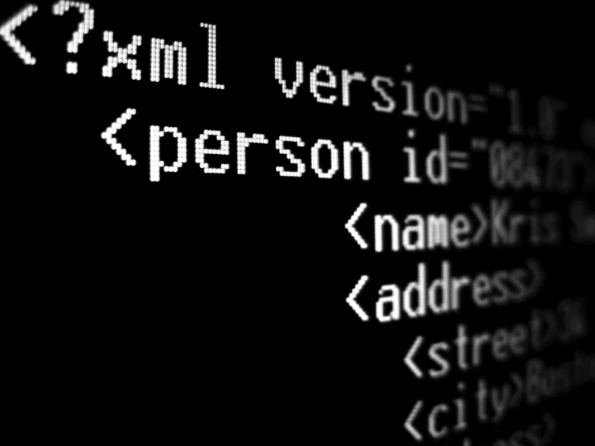
XML
HTML precursor to XML
XML ≠ HTML
XML – family of markup languages with similar structure
XML tags are application-specific
  Any alphanumeric string can be a tags
  Must follow rules
  Control interpretation of text only
  Not intended for human reading
  (eXtensible Stylesheet Language Transformation (XSLT) can transform XML to HTML and to CSS
  Cascading Style Sheets add styles to HTML documents

Slide 7

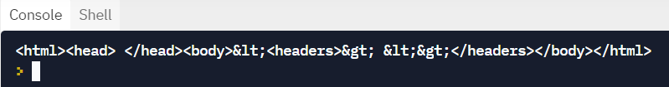
BeautifulSoup Module
  Used for parsing, accessing, and modifying HTML and XML documents
  Can construct BeautifulSoup object from a markup string, markup file, or URL of markup document
from bs4 import BeautifulSoup
#construct soup from a String
soup1 =BeautifulSoup("<HTML><HEAD><<headers>></HEAD><<body>></HTML>")
print (soup1)

Slide 8
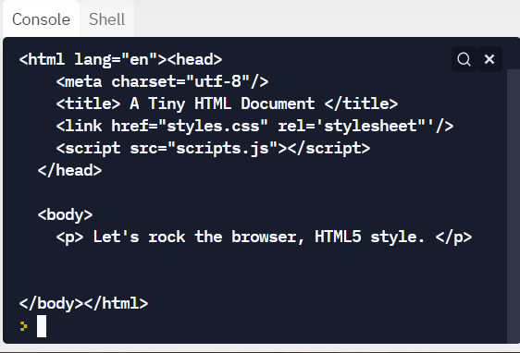
BeautifulSoup Ex. 2
from bs4 import BeautifulSoup
#construct soup from a local File
soup2 = BeautifulSoup(open("myDoc.html"),features="html5lib")
print (soup2)

Slide 9
BeautifulSoup Ex. 3
from bs4 import BeautifulSoup
from urllib.request import urlopen
#construct souop from a web document
#remember urlopen() does not add "http://"!
soup3 = BeautifulSoup(urlopen(http://www.networksciencelab.com/”),features=“html5lib”)
print (soup3)
Note second optional parameter:
  this is the markup parser and the default is =“html”

Slide 10
Markup Parsers
html– default, very fast, not lenient; used for simple HTML
lxml – (very fast, lenient)
Xml – for XML files only
html5lib – very slow, extremely lenient; used for HTML docs with complicated structure or is speed is not issue

Slide 11
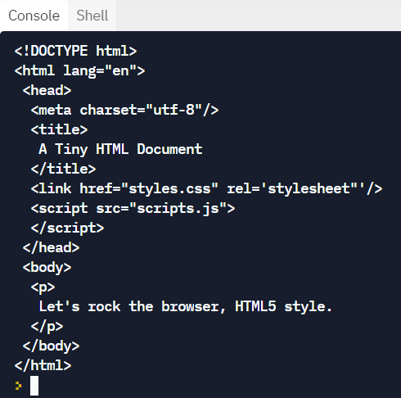
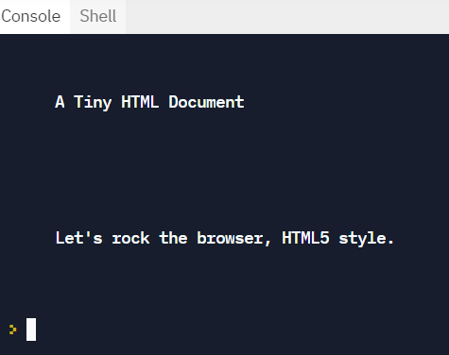
More BeautifulSoup functions
print (soup.prettify()) – indents (fig 1)
soup.get_text() returns text part of markup doc (fig 2)
Figure 2
Figure 1

Slide 12
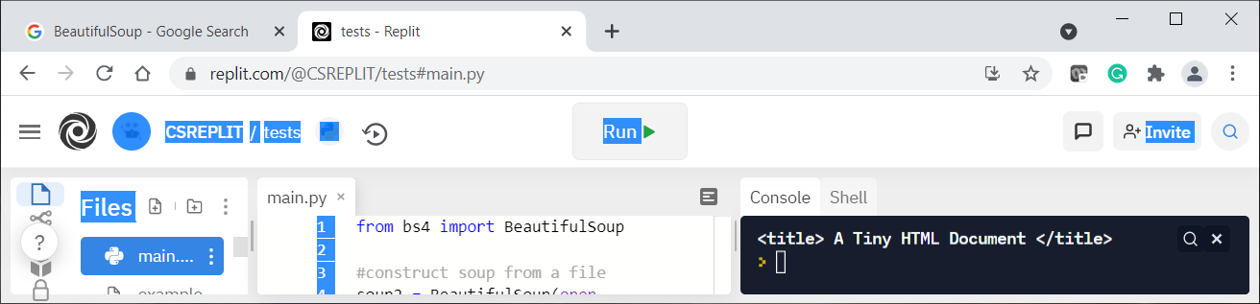
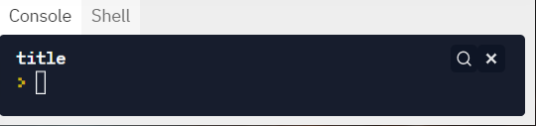
BeautifulSoup tag functions
Markup tags locate file fragments
print (soup2.title)
Any tag has a name, value, parent, next, prev tags, and children attributes
print (soup2.title.name)

Slide 13
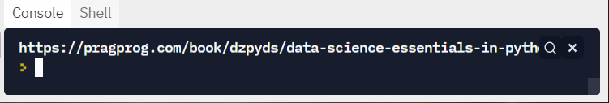
BeautifulSoup tag functions
Finds the first instance of a tag
print (soup2.find(“title”))
Finds all the instances of a certain tag
links = soup3.find_all("a") #returns list
if links[0].has_attr("href"): #check if present
print (links[0].get("href"))

Slide 14
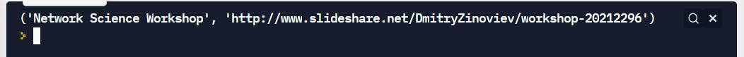
BeautifulSoup and list comprehension
To get all links and respective URLs and labels (useful for web crawling)
  from bs4 import BeautifulSoup
  from urllib.request import urlopen
  #construct soup from a file
  with urlopen("http://www.networksciencelab.com") as doc:
  soup = BeautifulSoup(doc, features="html5lib")
  links = [(link.string,link["href"])
  for link in soup.find_all("a")
  link.has_attr("href")]
  print(links[5])

Slide 15
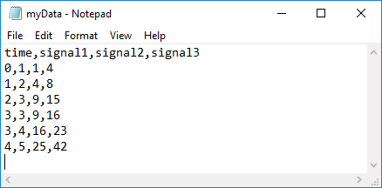
CSV Files
Structured file format for (nearly) tabular data.
Choice format for lots of spreadsheet software
  Excel, OpenOffice, data.gov (12,550+ data sites)
Consist of columns (variables) and rows(records)
Fields in record separated by commas (or other delimiters)
  What looks like a delimiter might not be data, “Hello, World”, data

Slide 16
Opening & Reading csv files
with open (“somfile.csv”, newline = ‘ ‘) as infile:
  reader = csv.reader (infile, delimiter = ‘,’, quotechar = ‘”’)
Delimiter and quotechar are optional parameters & there are others
First record in a csv file contains the column headers and is usually treated differently
reader provides an iterator interface for use in a for each loop
  Returns next record as a list of string fields
  does NOT do any conversions or stripping unless pass optional parameter skipinitialspace = True
  If file is not known and potentially very large, then read/process one at a time

Slide 17
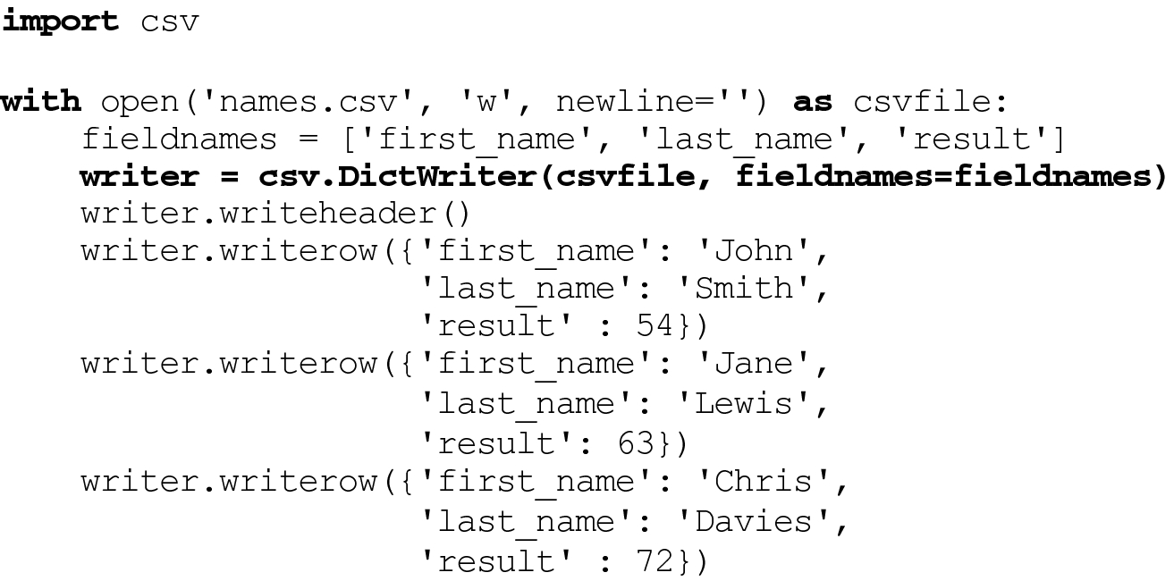
Writing CSV files
CSV writer provides functions for writing
  Functions writerow() – writes a sequence of strings or numbers as one record
  Function writerows() – writes a list of sequences
  Everything written as strings (so no conversion necessary)

Slide 18
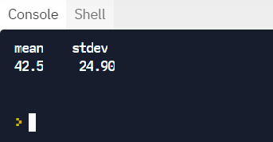
Example to extract “Answer.Age” column
import csv
import statistics
#open file and read data
with open("CovidDeathCounts.csv") as infile:
data = list(csv.reader(infile))
#examine header row to find column of interest
ageIndex = data[0].index("Age")
#access field of interest in records and calculate/display stats
ages = [int(row[ageIndex]) for row in data[1:]]
print ("mean\tstdev")
print(statistics.mean(ages), "\t", “{:.2f}”.format(statistics.stdev(ages)))

Slide 19
CSV and statistics vs pandas
Modules CSV and statistics are low-end, “quick and dirty” tools
Ch. 6: pandas data frames go beyond trivial exploration of a few columns

Slide 20

JSON files
Lightweight data interchange format
Language-independent, but more restricted in data representation then pickle
Many popular websites (Twitter, Facebook, etc) provide APIs that use JSON

Slide 21
JSON data types
Atomic types – strings, numbers, true, false, null
Arrays – corresponds to list, uses []s; elements do not have to be same type [1, 3.14, “a string”, true, null]
Objects – corresponds to dictionary, uses {}s
  {“age” :37, “gender” : “male”, “married” : true}
Any recursive (nested) combinations
Sets and complex numbers cannot be stored in JSON file, so must convert before exporting to JSON.
  Store a complex numbers as array of two doubles

Slide 22
Serialization/Deserialization in JSON
Functions in module JSON
  dump() exports ONE Python object to text file
  dumps() exports ONE Python object to a text string
  load() converts contents of a text file into one Python object
  loads() converts a valid JSON string into a Python object
Note: If an existing file contains more than one object, read it as text, convert to array of objects, and use loads() to deserialize the text
Note: When you save to JSON file, value of your variables are saved;
When you load, values become independent – they do not
reference the same variable. Hence the value of pickling.

Slide 23
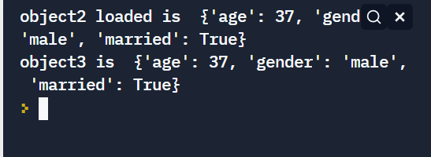
Code Fragment Sample
import json
object1 = {"age" :37, "gender" : "male", "married" : True}
#save an object to a file
with open ("data.json", "w") as out_json:
json.dump(object1, out_json, indent=None, sort_keys = False)
#load an object from a json file
with open ("data.json") as in_json:
object2= json.load(in_json)
print ("object2 loaded is ", object2)
#serialize an object to a string
json_string = json.dumps (object2)
#parse a string as JSON
object3 = json.loads(json_string)
print ("object3 is ", object3)

